Slide 1
Poster Figures
Lauren Kelly

Slide 2
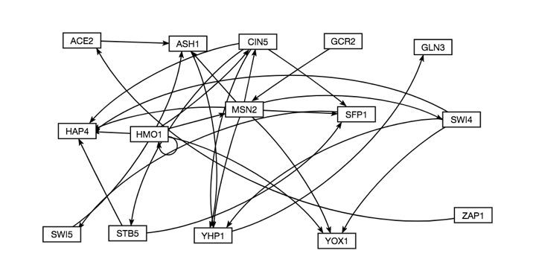
Unweighted db5 network
Notes:
Explain more about what this is

Slide 3
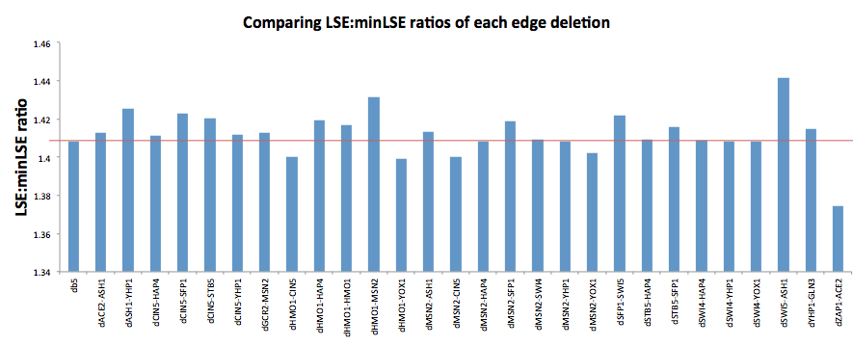
LSE:minLSE graph
Notes:
Sort from largest to smallest, color the db5 line with a different color
Fit improves in 5 cases. Most dramatic = zap1-ace2, also deleted zap1 here
dHMO1-CIN5: what does it look like over time with and without that edge. CIN5 vs. time with and without HMO1-CIN5 edge
dHMO1-YOX1: yox1 vs. time with and without MSN2, and with and without HMO1
dMSN2-YOX1
dZAP1-ACE2: ACE2 vs. time with and without the ZAP1 edge
Put the mean of the data and standard error on the graphs
Also show a deletion vs time where the model got worse

Slide 4
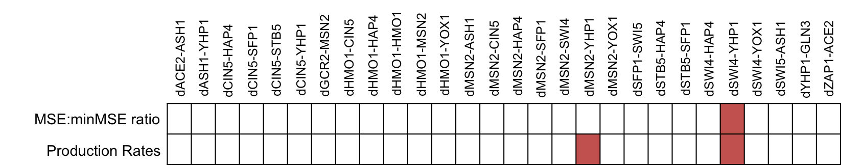
MSE:minSME ration and Production Rates
Shows the deletions that caused significant changes in the MSE:minMSE ratio and the production rates
Notes:
Paired T test
May not need the whole picture, maybe just use a table and talk more about the T tests

Slide 5
Some type of MSE:minMSE visual
TBD
Maybe about 5 graphs
Notes:
Experiment with some things, run them by Dr. Fitzpartrick/Dahlquist

Slide 6
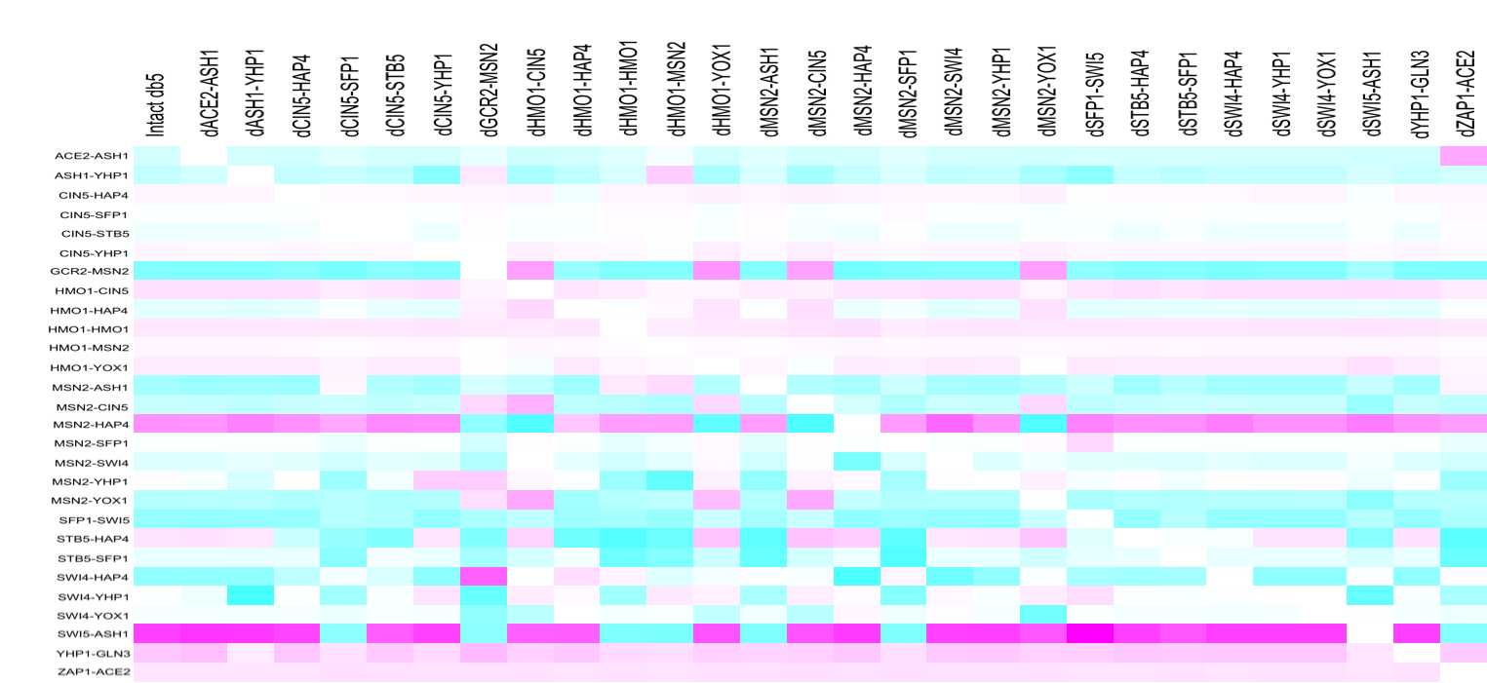
Edge Heat Map (table legend to be reformatted)
Notes:
The edge deletions that change a lot are associated with central genes (lots of edges going to and from them: CIN5, MSN2).
Perhaps have not gotten the dynamics of GCR2-MSN2 right quite yet
Interesting to illustrate where these things are in the network
HMO1-CIN5 and ZAP1-ACE2 potentially have a pretty big ripple effect.
HMO1-YOX1 and MSN2-YOX1 end at a dead end.

